Slide 1
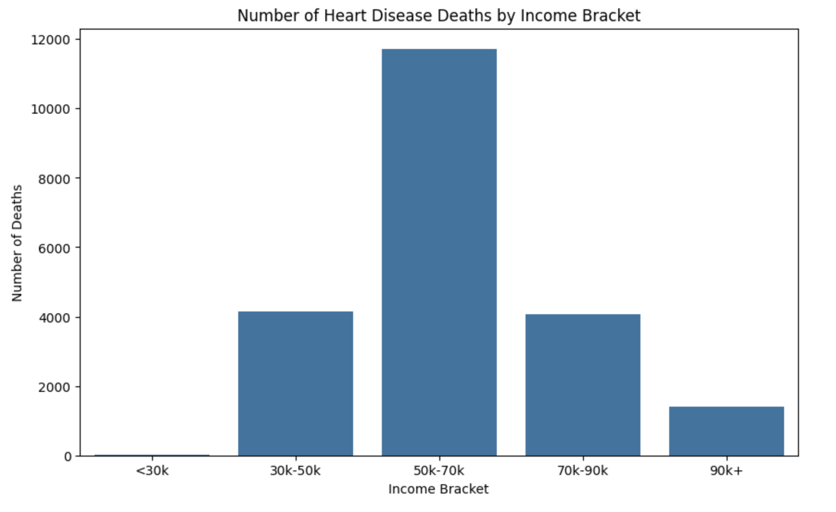
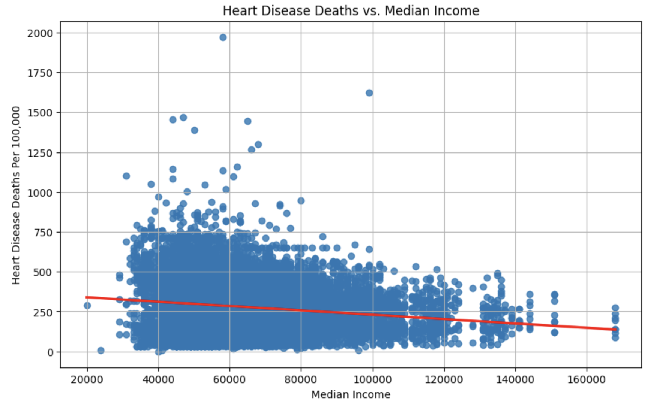
Income, GDP, and Ethnicity as Predictors of Heart Disease Mortality
Objective : To find a negative correlation between Heart Disease, GDP, and Median Income to
prove that higher income or GDP leads to less deaths from Heart Disease
Insight 1: Correlation Between GDP, Median Household Income, and Heart Disease Mortality
Finding the correlation will give us insight for whether or not there is a relationship between each statistic. To find the correlation between GDP, median household income, and heart disease mortality, we used Pearson's correlation coefficient.
Result:
GDP and Median Income: 0.2856338081942725
Median Income and Heart Disease Deaths: -0.14514628878247068
GDP and Heart Disease Deaths: -0.03364102420403973
Insight 3: Number of Deaths by Median Income
Insight 3 allows us to compare the total number of deaths between income brackets, which reveals what income group has the most deaths.
Result:
Deaths per Income Bracket:
<30k 7
30k-50k 4160
50k-70k 11721
70k-90k 4066
90k+ 1395
Insight 2: Average Death Rate By Ethnicity
The average of each ethnicity and the difference from the total overall average allows us to see and compare which ethnicities are more prone to heart disease mortality.
Ethnicity Average Deaths Difference
American Indian/Alaska Native 262.578918 -25.6
Asian 166.418831 -121.82
Black 451.810446 +163.58
Hispanic 184.976855 -103.26
More Than One Race 123.013156 -165.22
Native Hawaiian/Other Pacific Islander 412.342639 +124.11
Overall 368.701302 +80.47 White 377.647502 +89.41
Andrew Jiang and Kelly Zhang ♦ Video Link

